Slide 1


AUKUS Security Pact
The AUKUS Security Pact between Australia, the UK and the US undermines our sovereignty and will lead us into yet another unnecessary and disastrous US war
An explainer

Slide 2
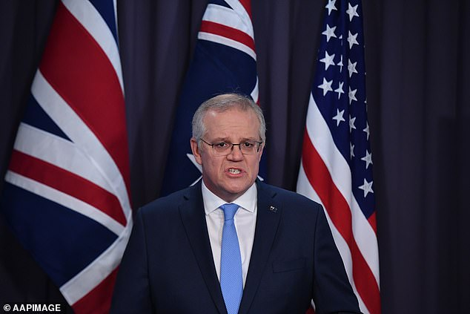
AUKUS Security Pact
First announced on 15th September, 2021 by former PM Scott Morrison without any parliamentary or public discussion, it was imposed in a non-democratic, authoritarian way on the people of Australia and their parliament.

Slide 3
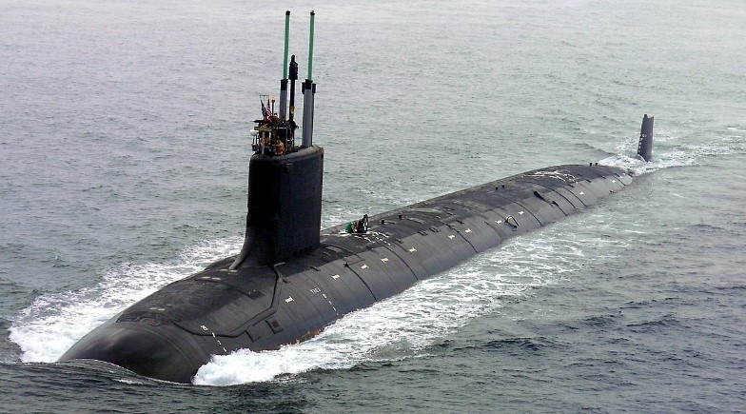
AUKUS Security Pact
The first component of AUKUS, Pillar 1, is the acquisition by Australia of nuclear-powered submarines with an estimated price tag of $375 billion. These huge hunter-killer submarines are designed for operation in deep waters distant from Australia, such as in the South China Sea.

Slide 4
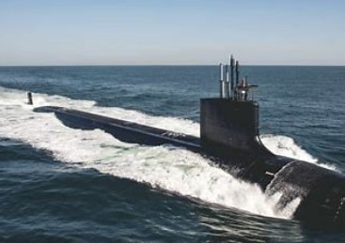
AUKUS Security Pact
Initially, three of these nuclear submarines are to be bought, second hand, from the United States in the 2030’s. The US expects Australia to deploy them together with their own nuclear submarine fleet in any of its war fighting actions. So AUKUS will draw Australia into the next US war which could be against China, our major trading partner and any such war risks becoming a nuclear war.

Slide 5
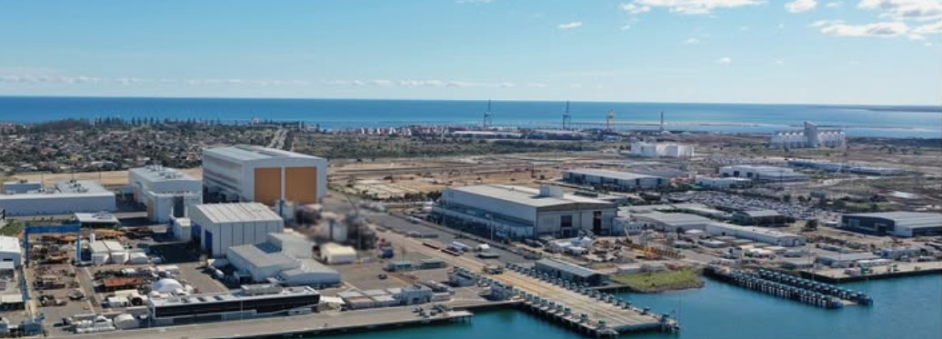
AUKUS Security Pact
Another five nuclear submarines, the SSN series, are to be designed in the UK and built/assembled largely in Adelaide’s Osborne Naval shipyards but the first of these is not expected to hit the water until well into the 2040’s. As the SSN class of nuclear submarines are yet to be designed let alone built, there is an anticipation that the cost of the AUKUS submarine acquisition will blow out significantly and may reach a trillion dollars.

Slide 6
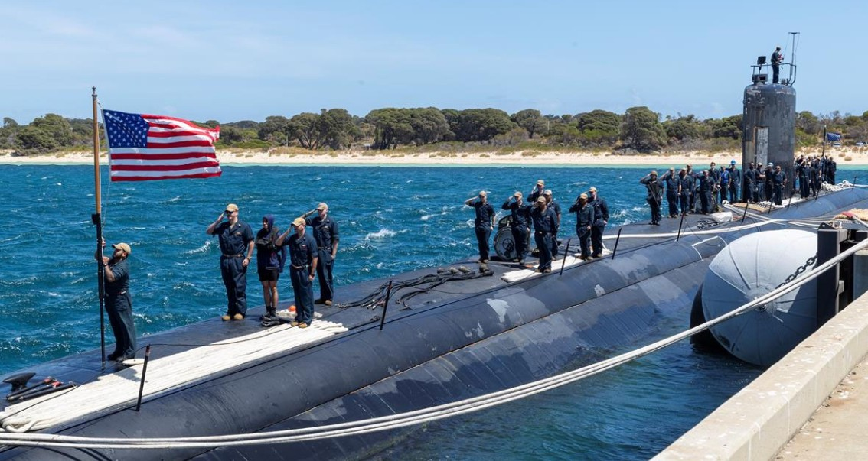
AUKUS Security Pact
The AUKUS Pact also provides for the US and UK to station at HMAS Stirling, Garden Island, WA, their nuclear submarines which may be nuclear-armed. Our government is spending $8 billion to establish suitable porting and maintenance facilities for their subs including a facility to store their low- level nuclear waste, the cost of which is yet to be determined.

Slide 7
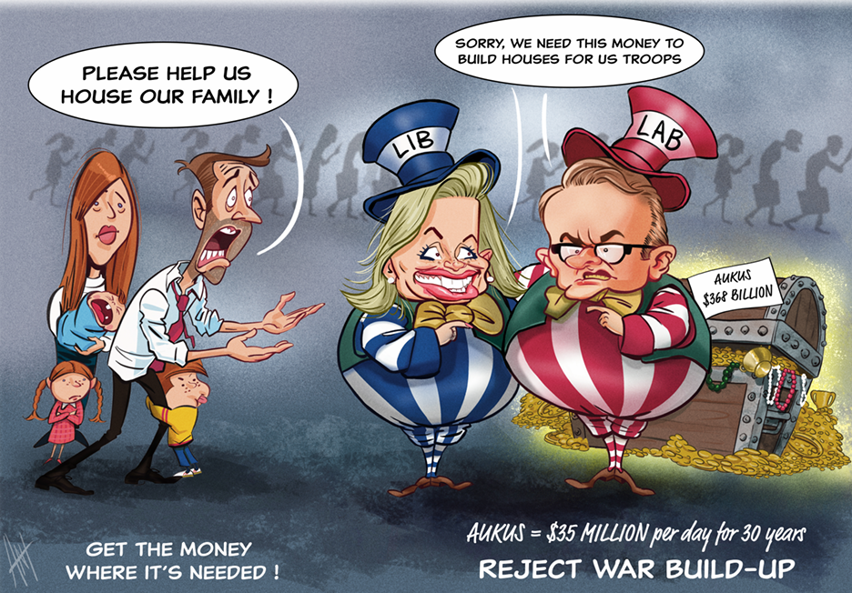
AUKUS Security Pact
In August, 2025 the Labor Party and Liberal Coalition united in the Senate to force through a Bill to enable public funding of 1,000 homes for US military and their contractors and families in WA so they can build the facilities and service the nuclear submarines to be ported there. This diversion of public funding to the US military is at a time when addressing homelessness for Australians is urgent social need.

Slide 8
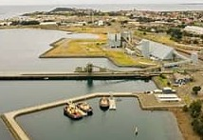
AUKUS Security Pact
By the end of this decade, the Australian Government will decide on the location of an east coast port for nuclear submarines. Port Kembla, Newcastle and Brisbane have been muted as possible locations. Community, including trade union, opposition to establishing a nuclear port at Port Kembla and at Newcastle has been already forcefully demonstrated.

Slide 9

AUKUS Security Pact
Australia is facing the worst housing crisis in decades
We are in the middle of a housing disaster — record rents, vanishing public housing, and entire families sleeping in cars. Spending $375 billion on nuclear submarines is diverting scarce public funds away from addressing this social crisis.

Slide 10
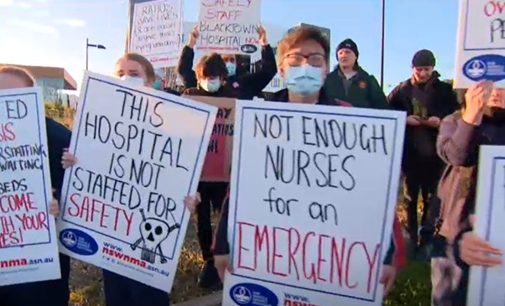
AUKUS Security Pact
The Australian healthcare system is facing a multifaceted crisis that requires urgent attention and reform to ensure the delivery of essential healthcare services to all Australians. For example, only three of 201 hospitals are delivering care within the recommended time frame. The AMA has called for a new national plan to address the backlog of surgeries and the need for increased hospital capacity. Some of that $375 billion on nuclear subs could be better spent on urgent hospital needs.

Slide 11

AUKUS Security Pact
AUKUS Pillar II
What are the implications of AUKUS Pillar II for us ?

Slide 12
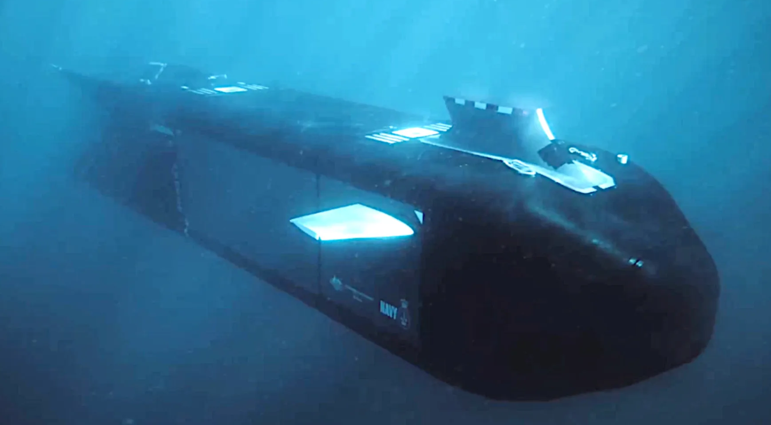
AUKUS Security Pact
Pillar 2 of AUKUS is based on Australia developing, in conjunction with the United States and for military use, the new discoveries in quantum physics, artificial intelligence (AI), hypersonic missiles, electronic warfare, advanced computing (cyber), and unmanned undersea vehicles (robot submarines).

Slide 13
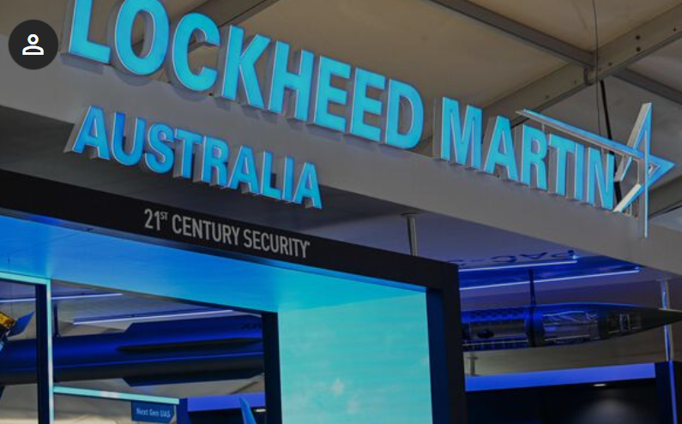
AUKUS Security Pact
AUKUS Pillar II means an expansion of the military-industrial complex in Australia dominated by US and other foreign corporations sucking up scarce Australian public funds as well as private capital, to expand.

Slide 14
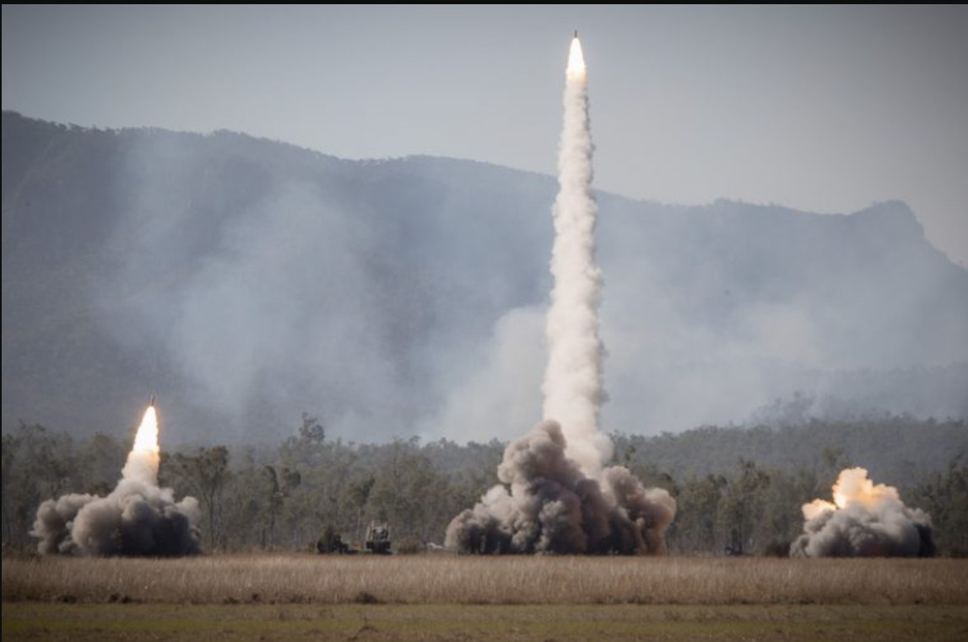
AUKUS Security Pact
Under Pillar II, Pat Conroy has signed an agreement with the US Department of War and Lockheed Martin for Australia to manufacture 4,000 precision strike guided multiple launch rocket system missiles, a proportion of which will go into the US war arsenal, at our expence.

Slide 15

AUKUS Security Pact
Australian defence industry will also be increasingly dominated by the big three US software corporations (which already dominate and surveil all of us), using massive data centres and military focussed artificial intelligence (AI) corporations such as Anduril and Palantir. Young enthusiastic Australians will be seduced into developing software for killing instead of software for social benefit.

Slide 16
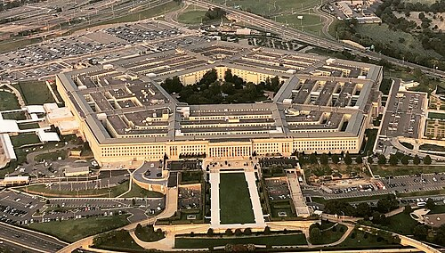
AUKUS Security Pact
Australian capital and research will be given to US military. The Pillar II focus on sharing technologies between partners means in practice a mostly one-way sharing that is towards the US and building up its war industry. So they will suck our brains for their benefit.

Slide 17
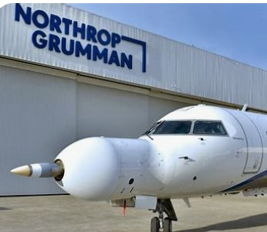
AUKUS Security Pact
Australian defence industry will continue to be dominated by US defence corporations and serve US war interests, Richard Marles has commented that “Our ultimate goal is to supplement and strengthen U.S. industry and supply chains, not compete with them.”

Slide 18

AUKUS Security Pact
The Australian defence force will become a US defence contractor. “Interchangeability” means that weapons can be used interchangeably – in practice that means Australian weapons will be an adjunct to the US weapons arsenal, but paid for by Australian taxpayers,
Australian industry is in effect integrated into the US military industrial complex – serving needs of US government and US military rather than Australia.

Slide 19
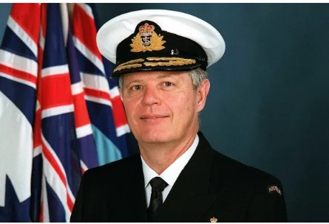
AUKUS Security Pact
Admiral Chris Barrie, former chief of the ADF, said in March,2025 that we need to re-think AUKUS as United States has become an unreliable ally under Donald Trump’s presidency and the Albanese government should urgently develop a plan B for Australia’s submarine fleet in case its AUKUS vision falls apart. He claims climate change not China is the major threat facing us.

Slide 20
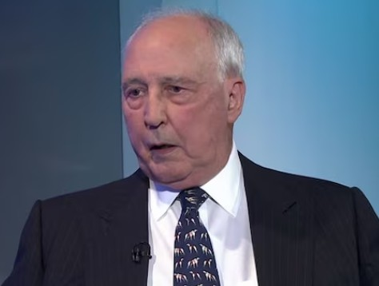
AUKUS Security Pact
Former prime minister Paul Keating has attacked the AUKUS agreement as Labor's "worst international decision" since it tried to introduce conscription, accusing his old party of "returning to its former colonial master, Britain".

Slide 21
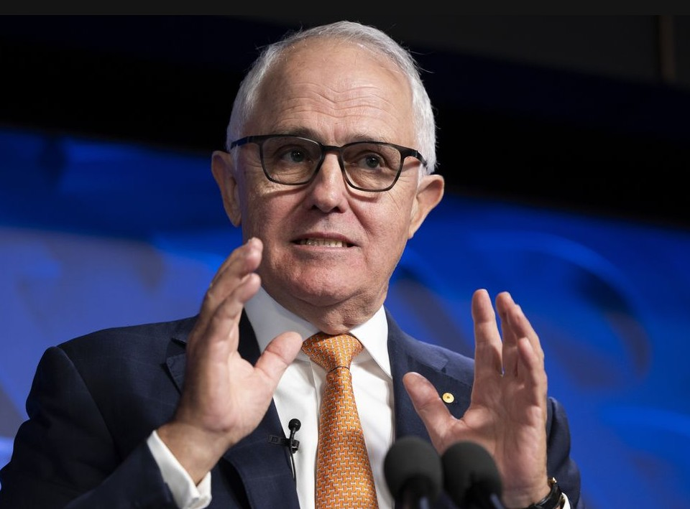
AUKUS Security
Pact
Former Prime Minister Malcolm Turnbull has described the AUKUS partnership as a "terrible deal" for Australia. "The most likely outcome of the AUKUS pillar one is that we will end up with no submarines of our own.“ He added: "We will have lost both sovereignty and security, and a lot of money as well. "That's why I say it is a really bad deal."

Slide 22

AUKUS Security Pact
Senator David Shoebridge has expressed strong opposition to the AUKUS Agreement arguing that is it a strategic and social blunder. He criticised the $375 billon investment in nuclear submarines, suggesting that they are not designed for Australian defence and would be part of a US fleet to project force against China. Shoebridge advocates for an independent defence strategy and believes Australia should distance itself from the US military and not engage in a war with China.

Slide 23
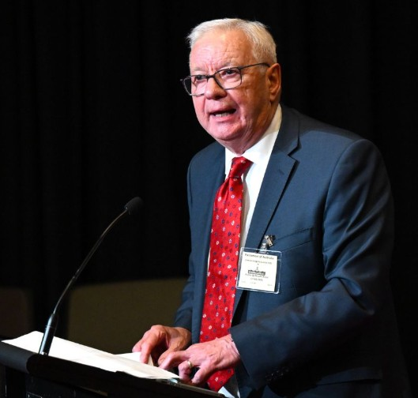
AUKUS Security Pact
Former Labor senator Doug Cameron has accused the Albanese government, and its left faction in particular, of deserting principle and abandoning Australian sovereignty to the United States. Cameron said AUKUS and the Force Posture Agreement (which covers the US’s military presence in Australia) reduced Australia’s sovereignty and boosted the likelihood Australia would be dragged into a war with China over Taiwan.

Slide 24
AUKUS Security Pact
IPAN’s Call on Government reads as follows:
Cancel AUKUS & terminate the FPA in order to STOP
• Nuclear submarines using Australian ports • Nuclear submarine waste being stored on Australian territory
• Nuclear capable bombers operating from Australia
• Use of Australian territory as a base for US war operations
• Australian cities becoming military targets.

Slide 25
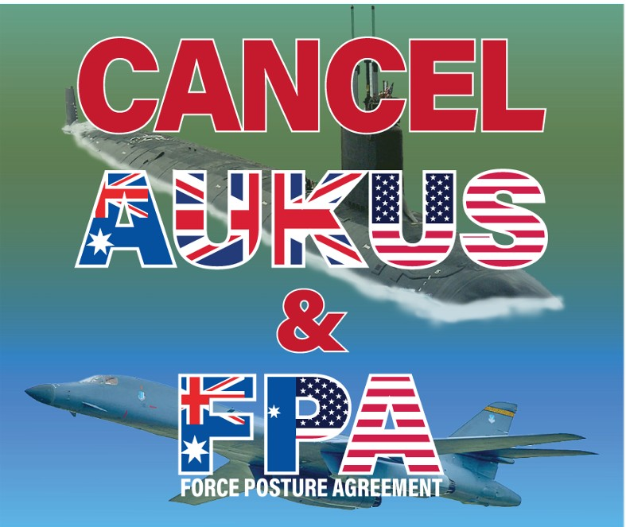

AUKUS Security Pact
This call on government can be signed here at:
https://ipan.org.au/public-call-to-the-australian-government/
Or using the QR code

