Slide 1



Alternative Defence 1
Peace,
independence
and a self-reliant, independent self-defence force
An explainer
The Independent and Peaceful Australian Network (IPAN) campaigns for a truly independent Australia, free from foreign domination and so able to pursue an independent foreign policy and promote peace in our region. Friends to all and enemies to none. Under these conditions, IPAN supports a true self-defence force to safeguard Australia’s territory, independence and security.

Slide 2

Alternative Defence 2
The path to peace and true Australian independence is blocked by
U.S. domination of Australia
United States domination of Australia, politically, militarily, economically and culturally is the main block to Australia becoming an independent and peace-loving country. Until this major obstacle is overcome, Australia can never have a truly independent, self-defence force and pursue peaceful relations in our region. Here we present a vision for our future - self-defence for a truly independent Australia with no dependence on, or involvement of, a foreign country.

Slide 3
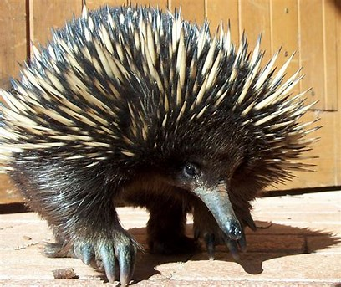
Alternative Defence 3
The Echidna inspires us to adopt an alternative defence strategy
The Echidna, exclusive to Australia, attacks no other creature and has developed exceptionally effective defensive protection which deters an attacker. It has survived for 100 million years on the Australian landmass.

Slide 4
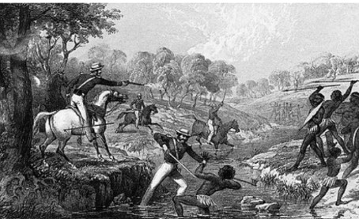
Alternative Defence - 4
The first invasion- The Frontier Wars
IPAN’s proposed alternative defence policy presupposes a genuinely independent nation with established Treaty(s) between the First Nations People and the settler community.

Slide 5
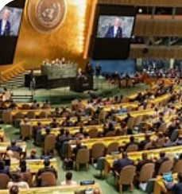
Alternative Defence - 5
The first line of defence
would be diplomacy.
An alternative self-defence policy would place primary reliance on the critical tools of diplomacy to foresee and resolve international differences and to develop positive and peaceful relations with all countries based on equality and mutual respect.

Slide 6

Alternative Defence - 6
Self defence policy based on non-nuclear, armed neutrality
Australia would embrace a policy based on the principle of “non-nuclear, Armed Neutrality”. Non-alignment could be a step towards neutrality. 'Neutrality' means that Australia would have no involvement in any wars between other countries. It would prevent Australian territory being used in such wars. This necessarily means ending foreign military bases on our soil.

Slide 7

Alternative Defence - 7
Neutral but not isolationist
This version of neutrality would not be isolationist. To the contrary, it would involve active involvement in international affairs opposing wars of aggression and occupation, hosting meetings between belligerents, acting as a mediator in disputes between countries and peace building in our region and wider. Austria practises such a version of Neutrality.

Slide 8
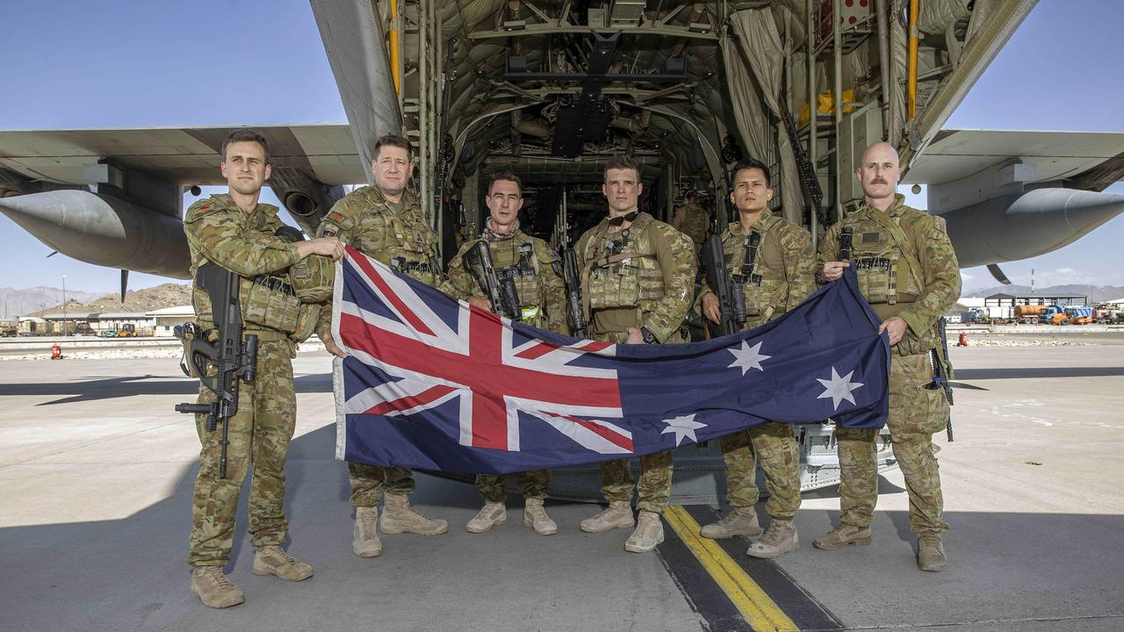
Alternative Defence - 8
Armed, trained & equipped for territorial self- defence only
‘Armed' means having the capacity to militarily defend Australia effectively against hostile incursions into our sovereign territory. Australia is ideally placed geographically to develop such a policy with a self defence, like the echidna, so prickly that the cost and pain (to an enemy) is not worth the gain.

Slide 9
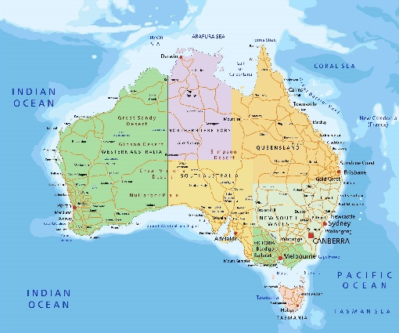
Alternative Defence - 9
Role of the Australian
(Self) Defence Force
The primary role of the Australian Defence Force (ADF) would be to safeguard Australian territory and its approach waters within Australia’s 200 nautical miles Exclusive Economic Zone (EEZ), including the area surrounding its offshore territories.

Slide 10

Alternative Defence - 10
Supporting United Nations peace keeping operations
Australia would contribute to United Nations peace-keeping and humanitarian operations as its contribution to regional and global peace. Australia would cultivate positive relationships with all countries and especially with other non-aligned countries, such as ASEAN and others in our region.

Slide 11
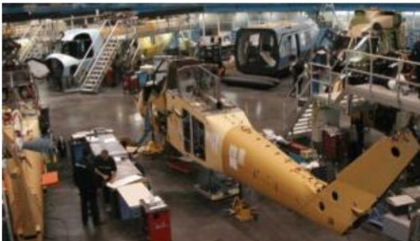
Alternative Defence - 11
A self- reliant defence requires:
* the reconfiguration/reform, re-training and equipping of the ADF
extensive development of a sovereign, publicly-owned Australian manufacturing & industrial base to provide support to defence–no privately or foreign-owned arms manufacturers
the development of all essential services and critical supply chains
When necessary, defence systems and material unavailable in Australia will be sourced from countries with similar defence postures and foreign policies to our own.

Slide 12
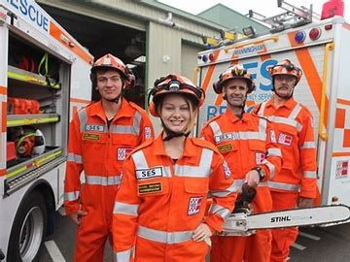
Alternative Defence - 12
National involvement by civilians required
This alternative defence policy will involve national participation by the majority of Australians, since self-defence extends well beyond military service and includes civil and social defence preserving supply chains and other essential needs and with significant support from part-time emergency reserve forces.

Slide 13
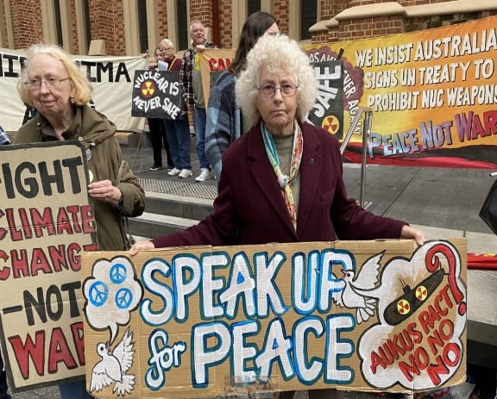
Alternative Defence - 13
Australians support neutrality and keeping out of a US war on China
This proposed alternative defence policy based on non-nuclear, armed neutrality currently has support from the Australian people. According to two national opinion polls in 2023 (Lowy Institute and Essential Research), a clear majority of Australians favour Australia staying out of a US-led war with China and adopting a neutral position.

Slide 14

Alternative Defence - 14
No conscription and full respect for conscientious objectors
It is expected that defending the territory of an independent Australia and its neutrality will stimulate a broad patriotic voluntary response that will meet all the military and civil defence needs. Conscription will not be necessary. Conscientious objections to participating in any war will be respected and made a legal right.

Slide 15
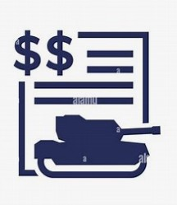
Alternative Defence - 15
What about the cost of a true self defence policy ?
Some people say it would cost us more to have a self -reliant, independent defence. Others say it would cost less. The Swiss have practiced armed neutrality for many decades and their expenditure on military defence in 2020 was 0.7% of their GDP. Australia’s defence spending in 2019-2020 was 2.1% of GDP- three times as much, as percentage of GDP.

Slide 16
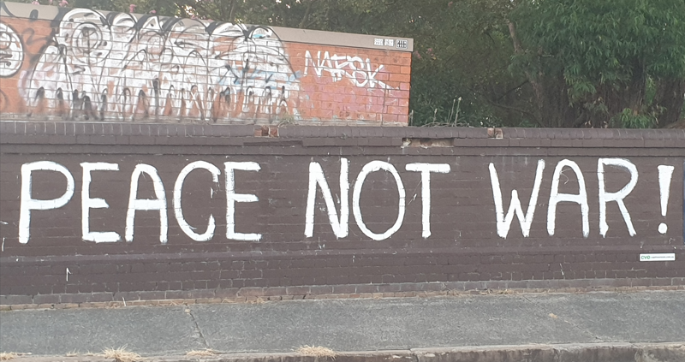
Alternative Defence - 16
Where to from here?
The adoption of an independent foreign policy with neutrality and territorial self defence is currently blocked by the US grip on Australia, politically, militarily and economically. Only a huge, broad-based united people’s movement will generate the political pressure to overcome this blockage and enable the adoption of the neutrality option to keep us safe and out of foreign wars. This is our mission!

